Slide 1
DesignDeck : A Creative Portfolio Platform
DesignDeck is a collaborative portfolio platform where designers and developers can showcase their work through interactive project uploads. The platform allows users to create and manage portfolios, upload images and videos, and display projects on their profile.
Designed and developed by : Patel Twinkle , Harsh Vekariya
Instructor : Honey Patel
CPC - GU
09-04-2025

Slide 2
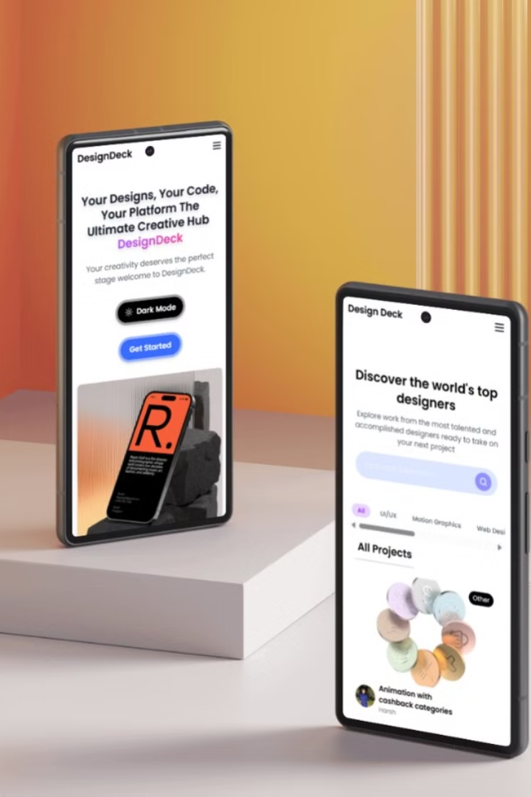
Project Objectives
1
User-Friendly Platform
Build an intuitive platform for showcasing portfolios.
2
Secure Authentication
Implement secure authentication and user management.
3
Intuitive Admin Dashboard
Develop an admin dashboard for backend management.
4
Easy Project Uploading
Enable simple project uploading and profile customization.

Slide 3
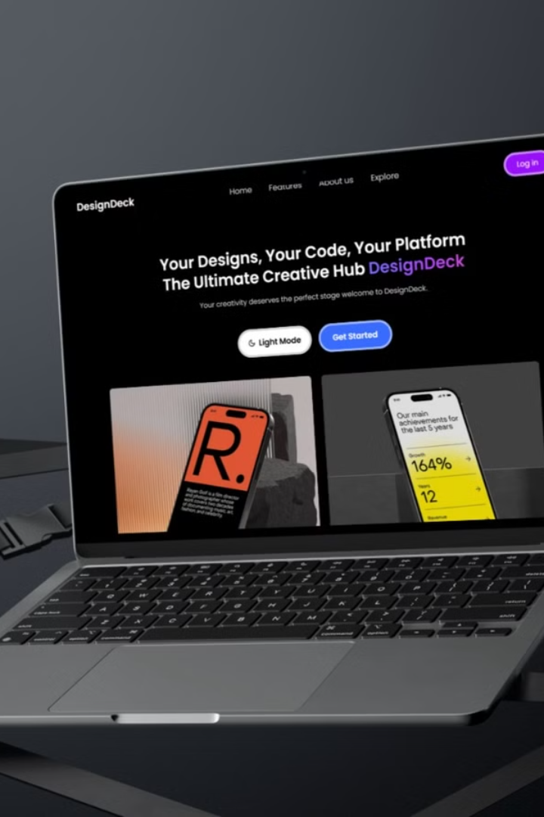
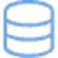
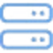

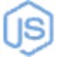
Technical Methodology: MERN Stack
MongoDB
Express.js
React
Flexible document storage
Robust backend routing
Dynamic frontend
Node.js
Server-side performance

Slide 4
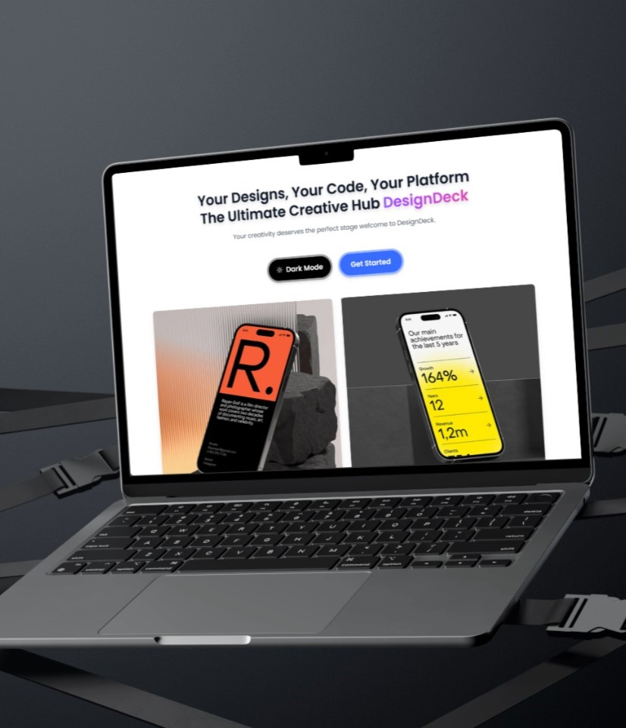
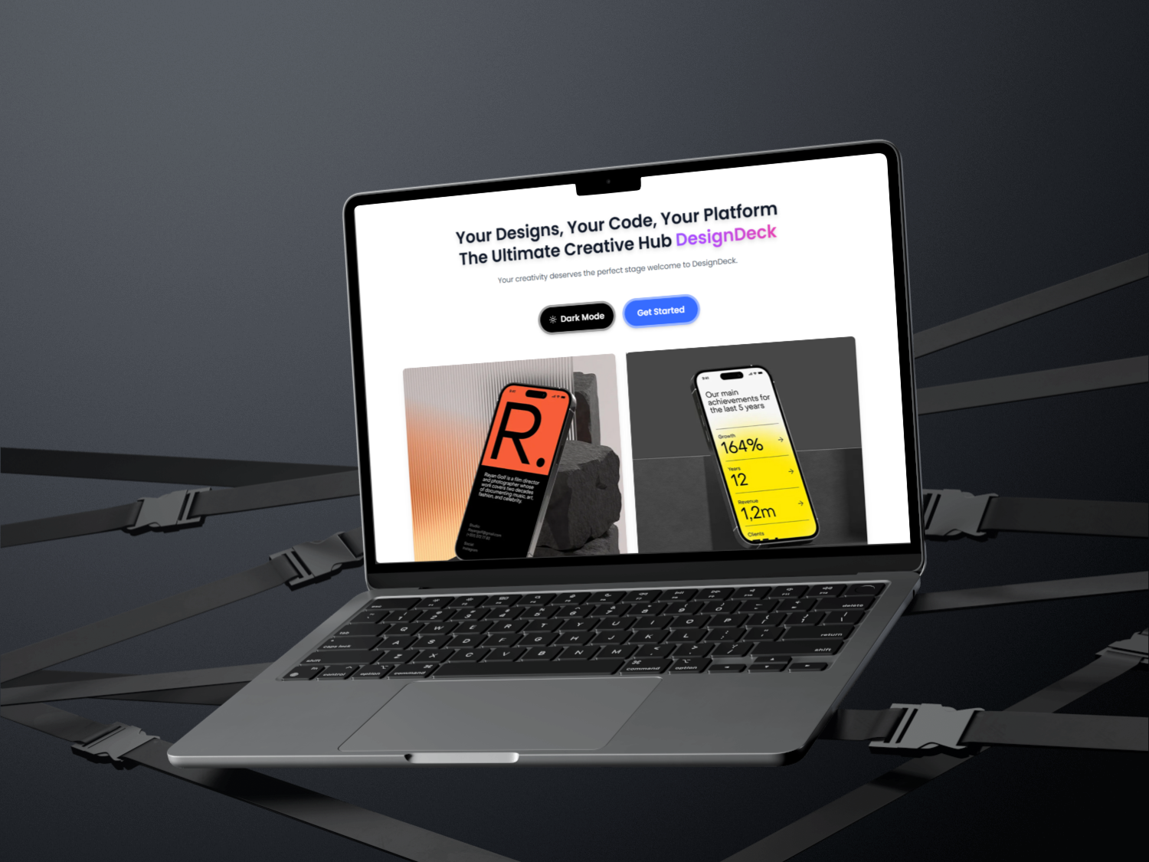
System Architecture
Frontend
React.js (SPA with routing).
Backend
Node.js + Express API.
Database
MongoDB Atlas.
Authentication
JWT-based system.

Slide 5
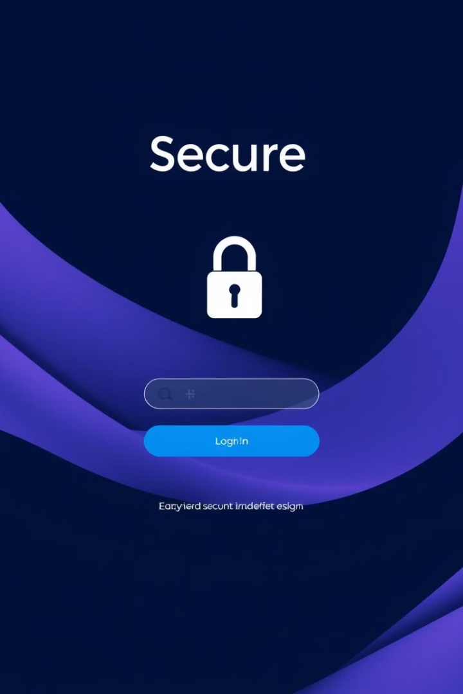

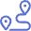
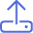
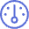
Key Implementations
Authentication
Routing
Project Upload
React Router DOM.
JWT, bcrypt for password security.
Form with file input & metadata.
Admin Panel
Manage users & content.

Slide 6
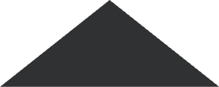
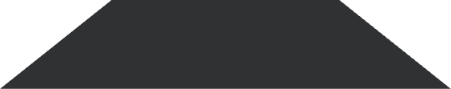
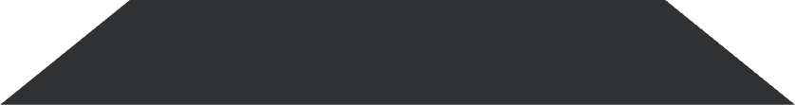
User Experience Design
1
Intuitive Interface
2
Clean Design
3
Responsive
DesignDeck focuses on an intuitive drag-and-drop portfolio creation. The interface is clean and minimalist. Responsive design ensures seamless project management on mobile and desktop.

Slide 7

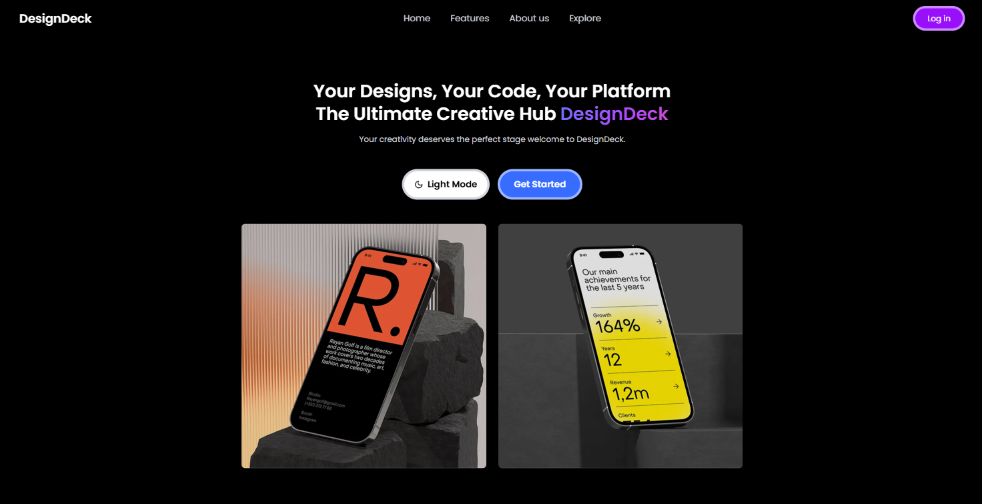
Landing Page
Responsive Layout Seamlessly adapts to all screen sizes—desktop, tablet, and mobile.
Compelling Tagline Summarizes the platform’s value in one powerful line.
Feature Highlights Quickly explains main features like uploading, liking, and following.
User-Focused Experience Built with simplicity and ease-of-use to guide new visitors.
Concise Footer Contains essential links like About, Contact, and Terms in a minimal format.

Slide 8

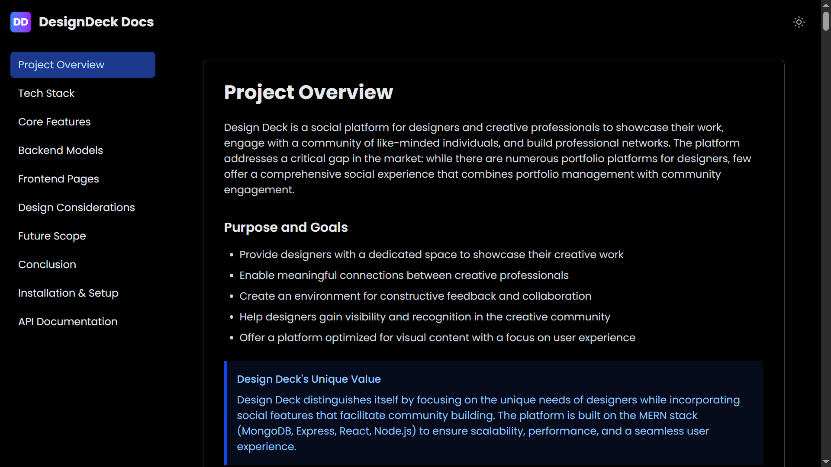
Documentation Page
Step-by-Step Guidance Clear instructions for users to create and manage their project documentation.
Dark Mode Support Comfortable viewing for users working at night or in low-light environments.
Minimal & Focused UI Clean layout that highlights content without distractions—perfect for creatives.
Responsive & Accessible Design Readable and functional on any screen size or device.
Smooth Transitions & UI Animations Polished experience with subtle motion to enhance user flow.

Slide 9
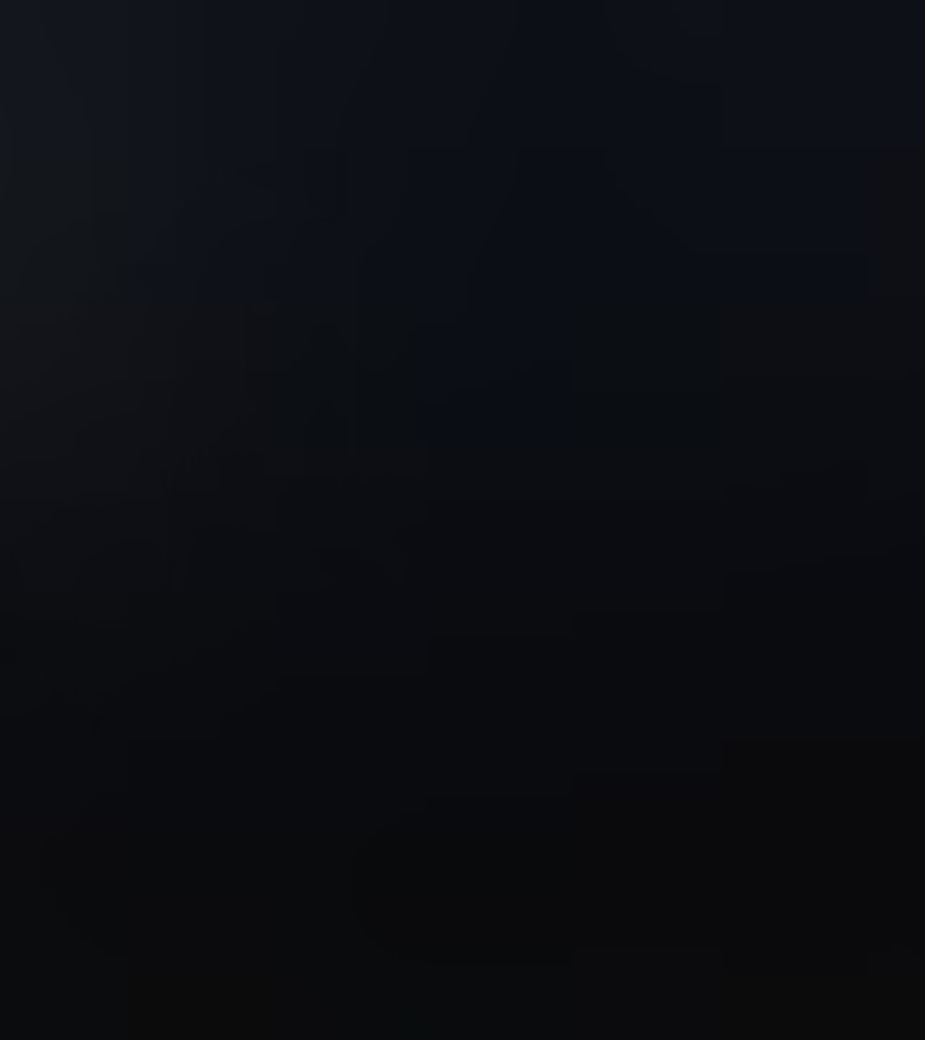
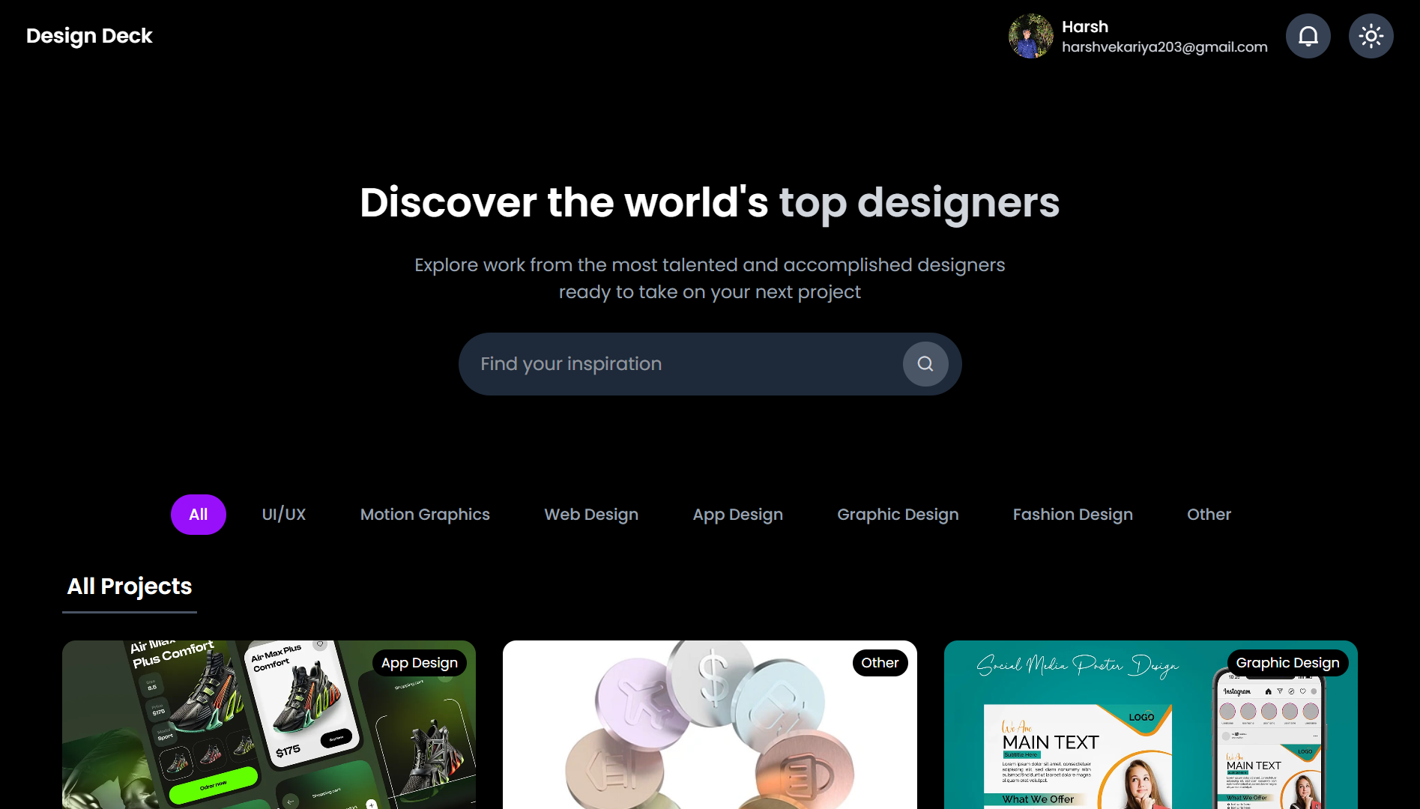
User Dashboard
Trending & Recent Projects Highlights what's popular and newly uploaded across the platform.
Interactive Cards Project cards show previews, likes, and author info.
Clean Grid Layout Modern and responsive design with intuitive navigation.
Mobile-Friendly Interface Optimized layout and interactions for small screens.
Performance Optimized Fast loading and smooth transitions for a seamless experience.

Slide 10
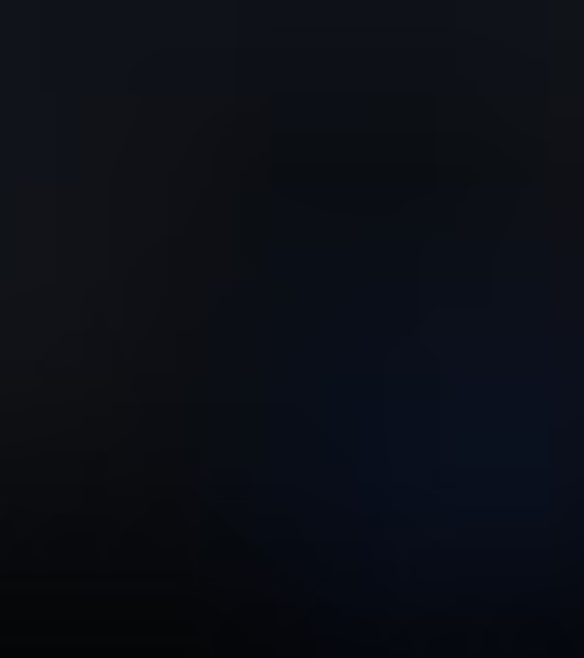
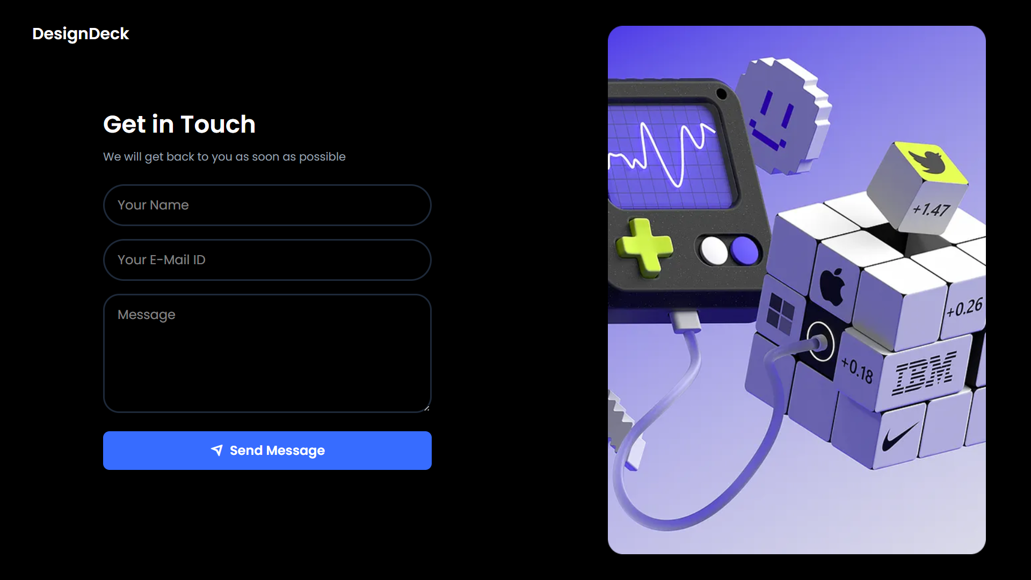
Contact Us Page
Simple & Clean Layout Easy-to-navigate design with clear sections for contact info and forms.
Contact Form Section Fields for Name, Email, Subject, and Message with validation.
Submit Confirmation Message Success message after form submission.
Responsive Design Looks and works great on both mobile and desktop.
Accessibility Features Keyboard navigation, screen reader support, and proper contrast.

Slide 11
Admin Control Center
User Management
Role display
User Deletion
View all user, check active status and last login time.
Show roles as User or Admin for clear identification
Admin can delete a user if necessary for platform management

Slide 12
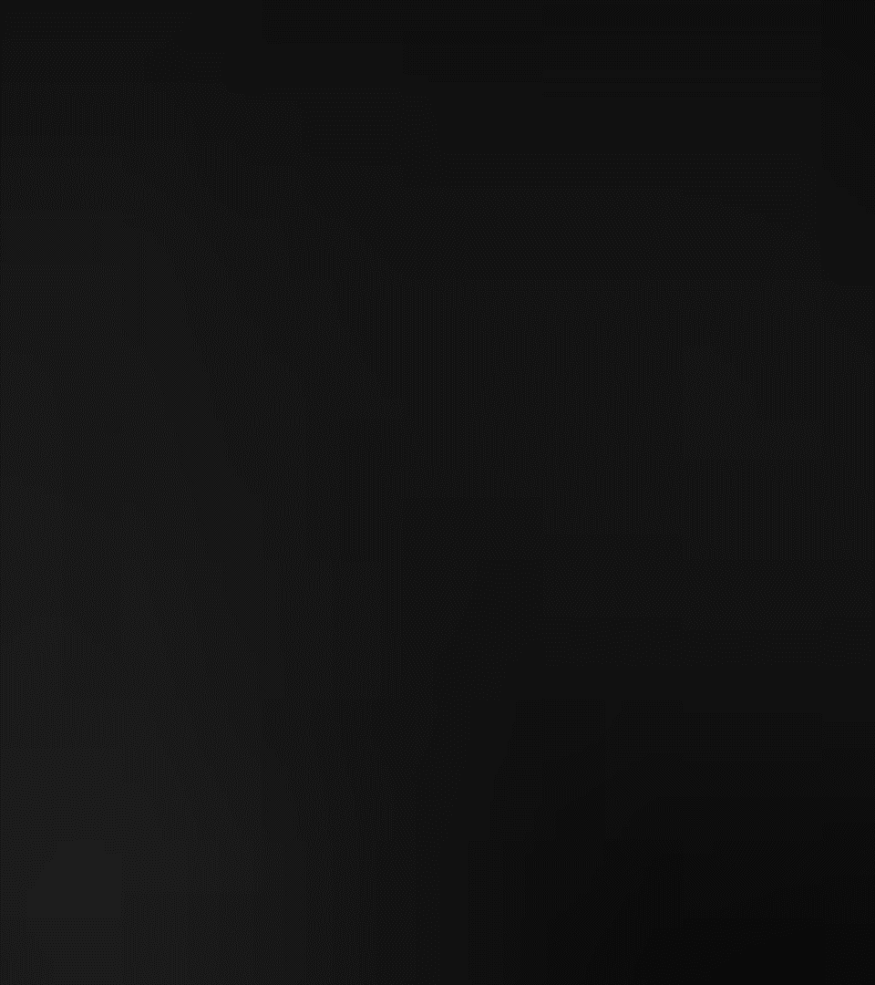
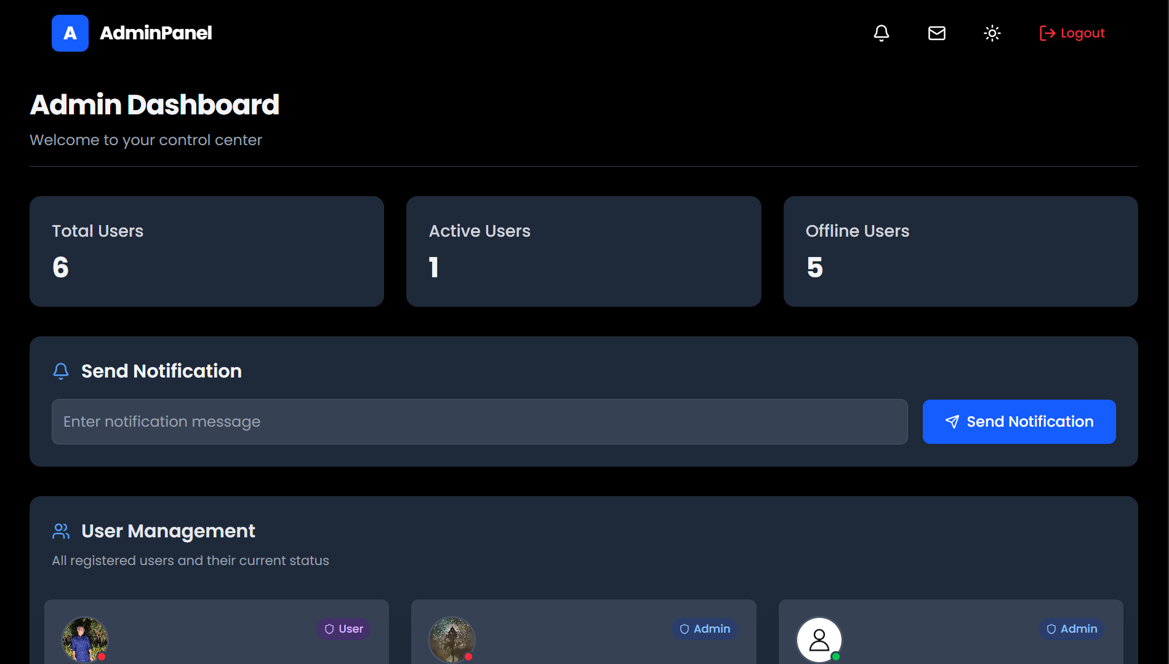
Admin Panel
View User List Display all users with delete action beside each entry.
Permanent Removal from Database Completely delete user data from MongoDB
Send Email & Notification Quickly message users via email and real-time in-app alerts.
Show Online Status Indicates which users are currently online in real time.
Last Login Timestamp Display when each user last accessed the platform.

Slide 13
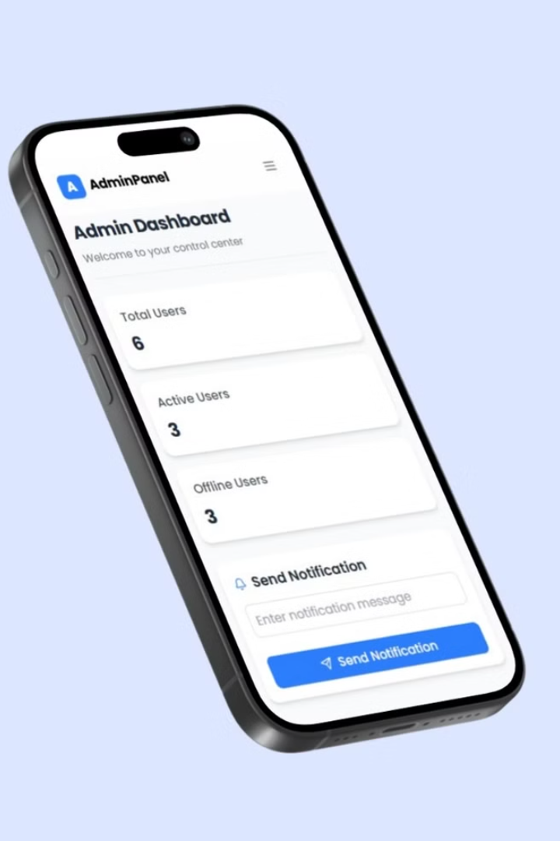
Email System
Email System
1
Implement a mailing system. Admins can send mail to all users.
2
Notifications
Develop a notification system. Keep users informed and engaged.

Slide 14
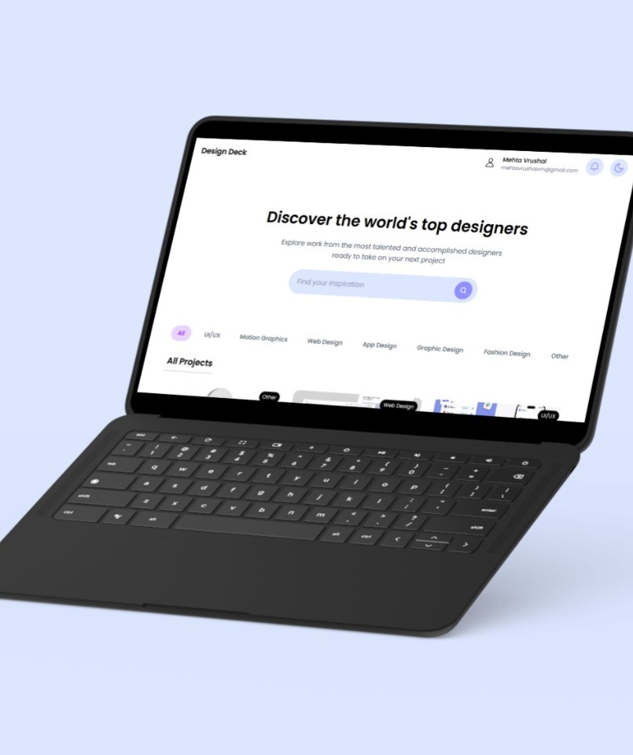
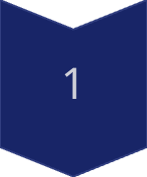
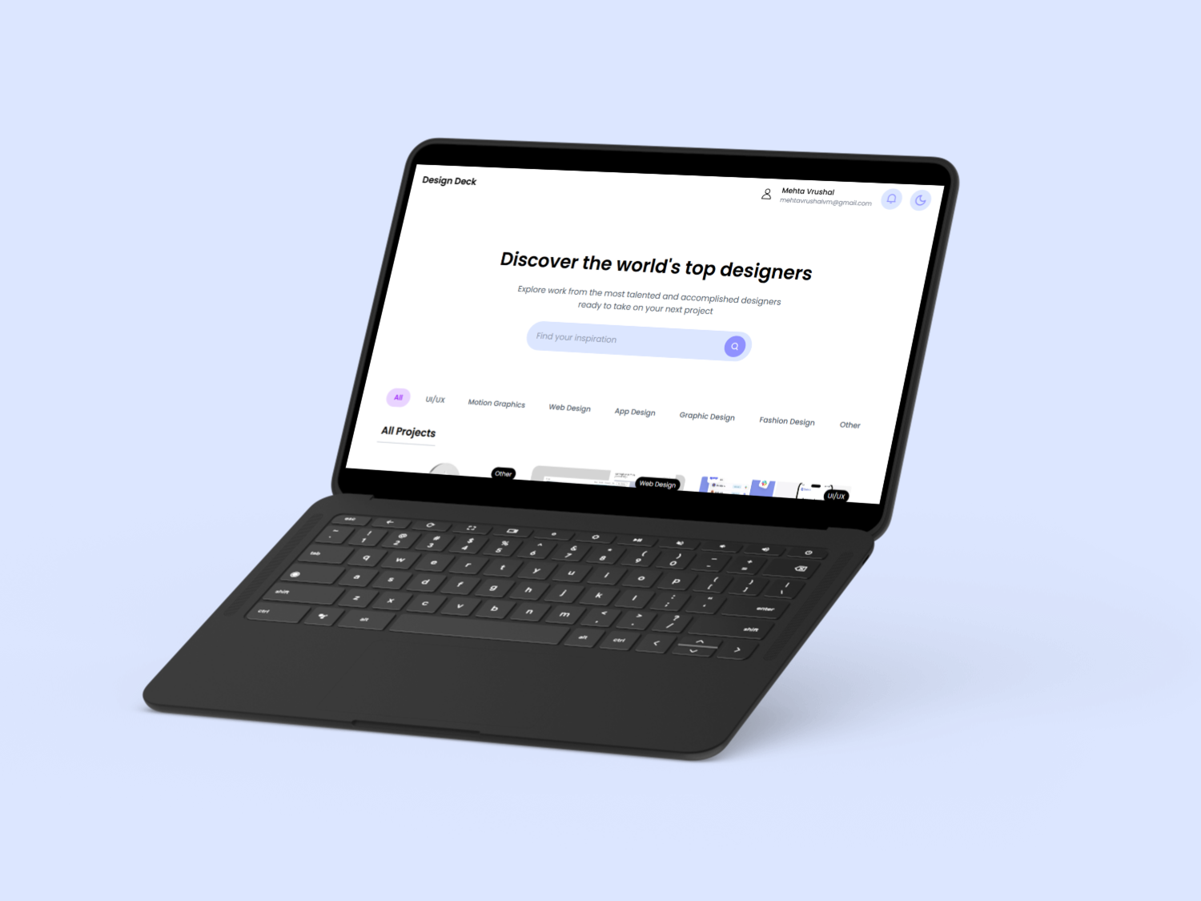
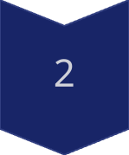
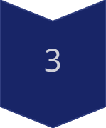
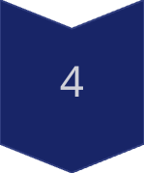
Results & Findings
Functional Web App
Fully functional MERN-based web app.
Responsive UI
Responsive UI tested across devices.
Secure Access
Secure login/signup & role-based access control.
Project Display
Project upload and display working.

Slide 15
Future Scope
1
Comment System
2
Search & Filter
3
Cloud Deployment
DesignDeck is a portfolio platform with a dynamic frontend. Future enhancements include cloud deployment and a search/filter system.

Slide 16
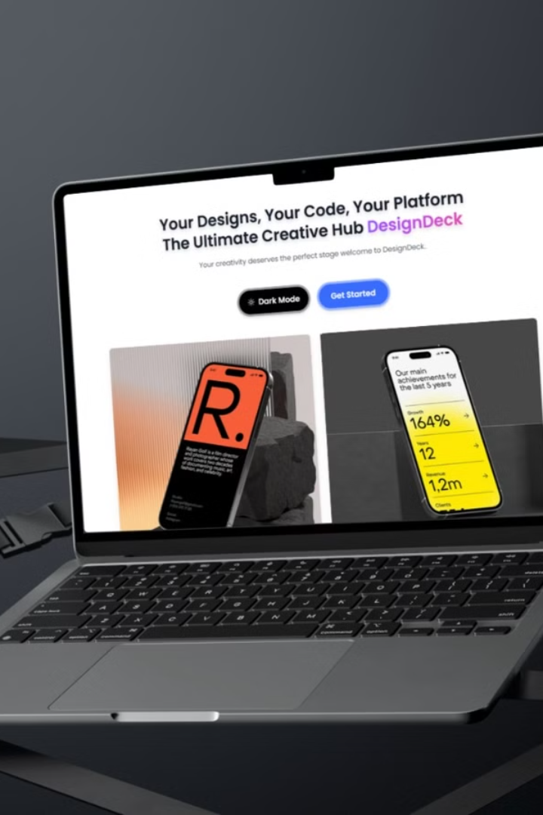
Thank You
Thank you for your time and consideration.

